Slide 1

Climate Change Data Analysis
Bhoomika Patel
Jaewon Kim
Preeti Chouksey

Slide 2
Questions
WorldBank collected data of possible causes of climate changes and average monthly temperature on countries around the world over 10 years
Selected countries and causes are analyzed to identify the relationships to answer the questions below;
Is temperature change occurring on all countries?
Did energy use increase with increased GDP?
Did CO2 emission increase as population increase?
Did population increase affect cereal yield(%)?

Slide 3
Data Sources
https://climateknowledgeportal.worldbank.org/download-data
https://www.kaggle.com/theworldbank/world-bank-climate-change-data#climate-change-excel-4-6-mb-.xls

Slide 4
Coutnries
India
Australia
Chile
China
Canada

Slide 5
Causes of Climate Changes Used for Analysis
Population
CO2 emissions per units of GDP (kg/$1,000 of 2005 PPP $)
Energy use per units of GDP (kg oil eq./$1,000 of 2005 PPP $)
GDP ($)
CO2 emissions, total (KtCO2)
Cereal Yield (%)

Slide 6
Causes of Climate Change Analysis

Slide 7
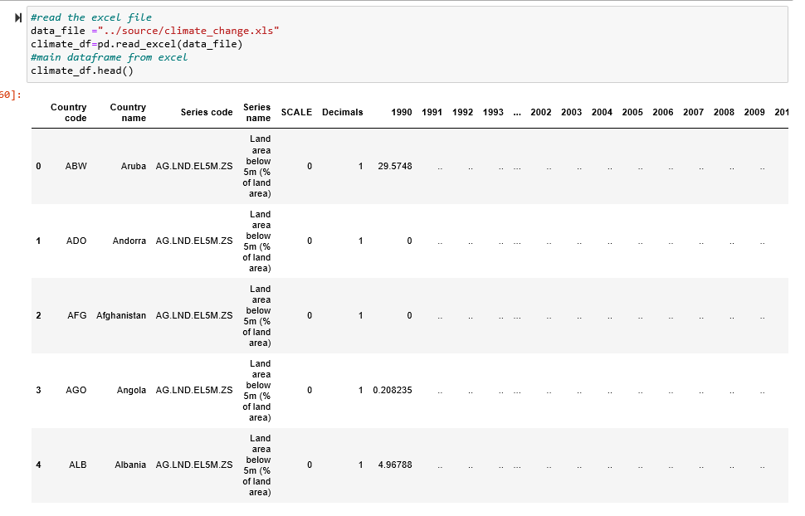
Cleaning Data – 1st Step

Slide 8
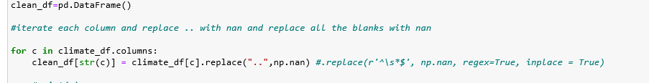
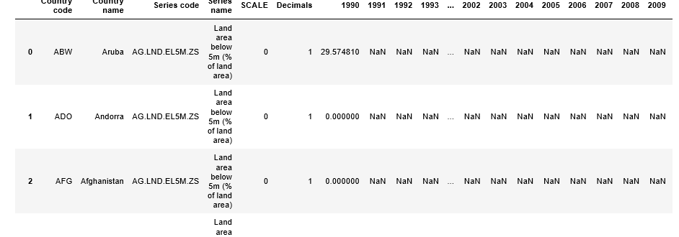
Cleaning Data – 2nd Step

Slide 9
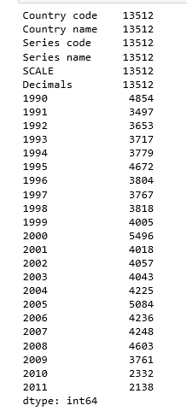
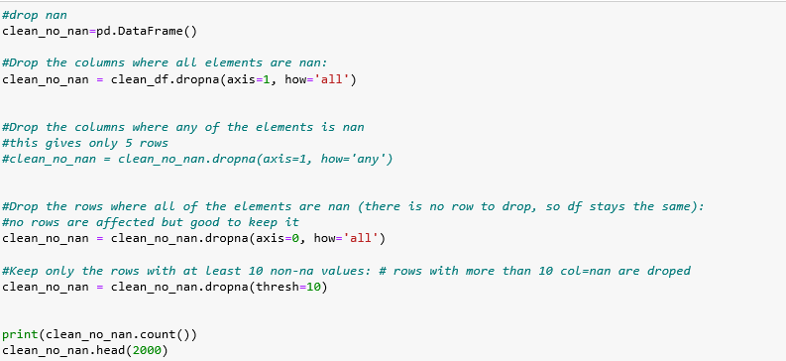
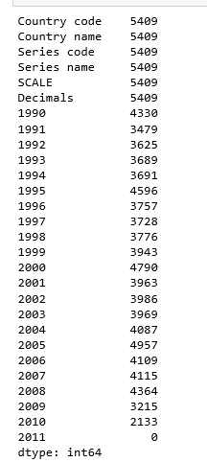
Cleaning Data – 3rd Step

Slide 10
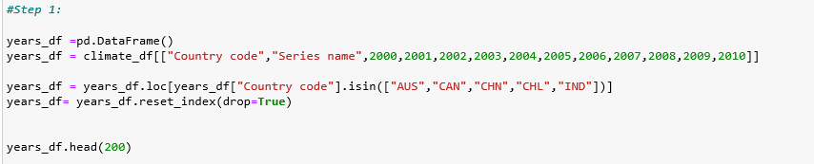
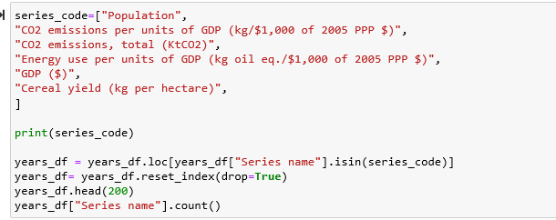
Analyzing Data – 1st Step

Slide 11
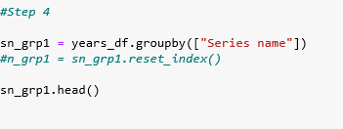
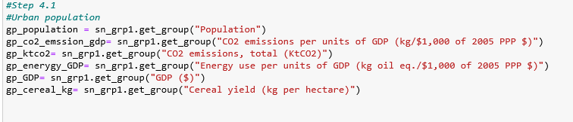
Analyzing Data – 2nd Step

Slide 12
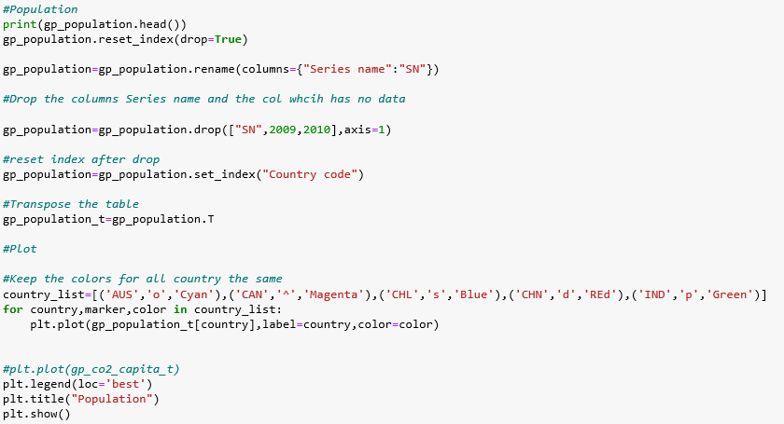
Analyzing Data – 3rd Step (Plotting)

Slide 13
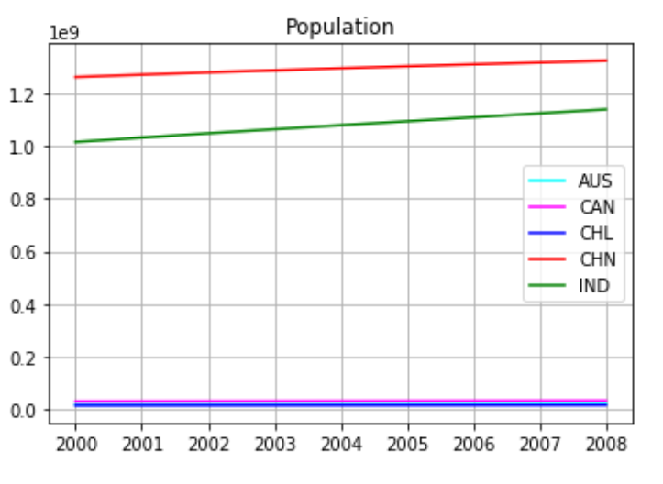
Population (2000-2008)
More Housing
More Agriculture land
Less forest directly

Slide 14
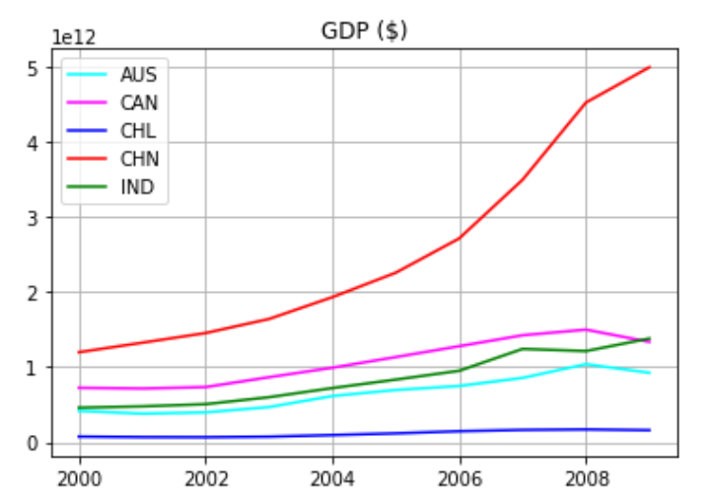
GDP($) (2000-2008)
More Urban Development
More Factories
More Vehicles
Less forest
More Urban Development
More Factories
More Vehicles
Less forest

Slide 15
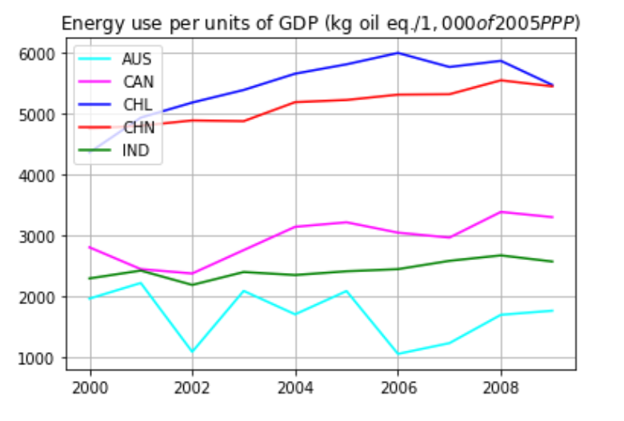
Energy use per units of GDP (2000-2008)
More Natural Resources used to produce energy
More CO2 Emission from factories and vehicles
More Transportation
Less forest

Slide 16
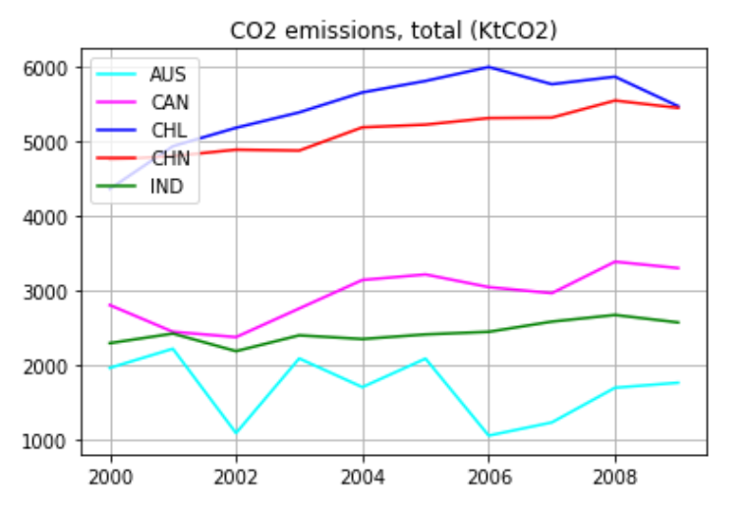
CO2 emission, total(KtCO2) (2000-2008)
More Natural Resources used to produce energy
More CO2 Emission from factories and vehicles
More Transportation
Less forest

Slide 17
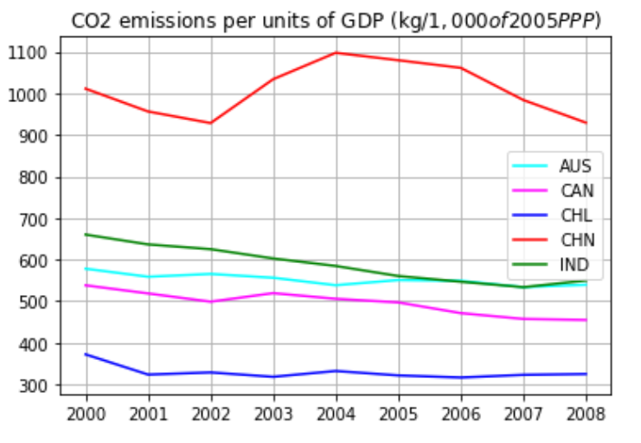
CO2 emission per units of GDP (2000-2008)
More Urban Development
More Factories
More Vehicles
Less forest
More Natural Resources used to produce energy
More CO2 Emission from factories and vehicles
More Transportation
Less forest

Slide 18
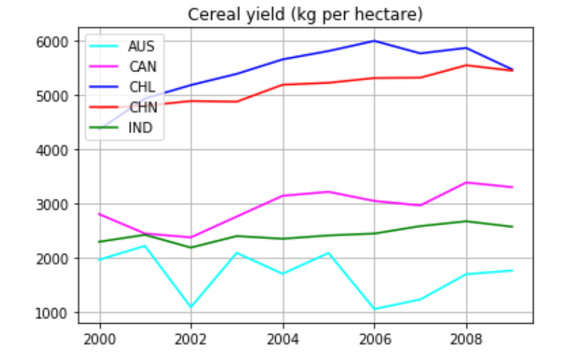
Cereal Yield (2000-2009)
More Urban Development
More Factories
More Vehicles
Less forest
More trees cut down to increase the farmland
More Transportation
Less forest

Slide 19
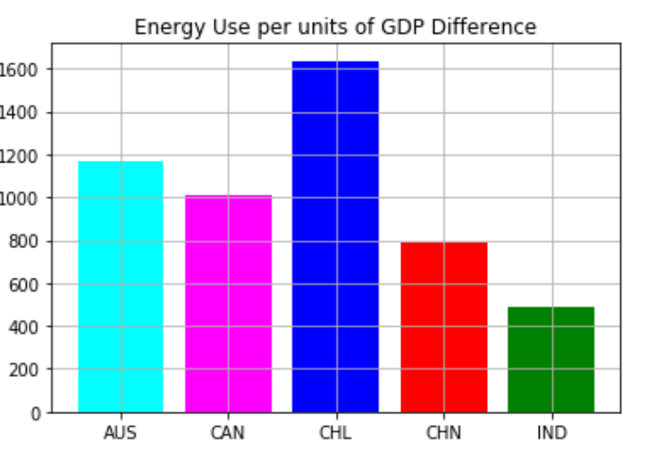
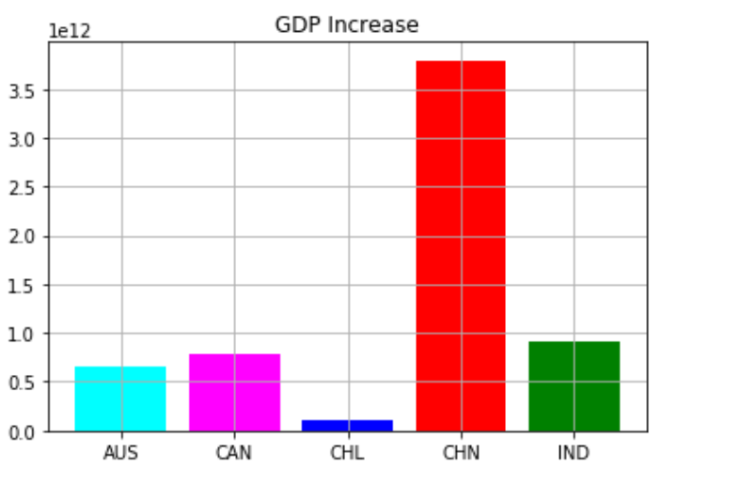
Question Answered!
Did energy use increase with increased GDP?
Chile has highest energy use increase per units of GDP, which is 1600kg of oils. But their GDP increase is smallest among 5 countries compared. GDP increase for CHL is 150 billion.

Slide 20
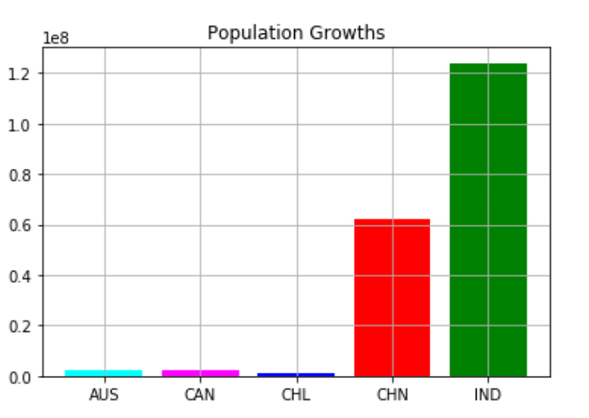
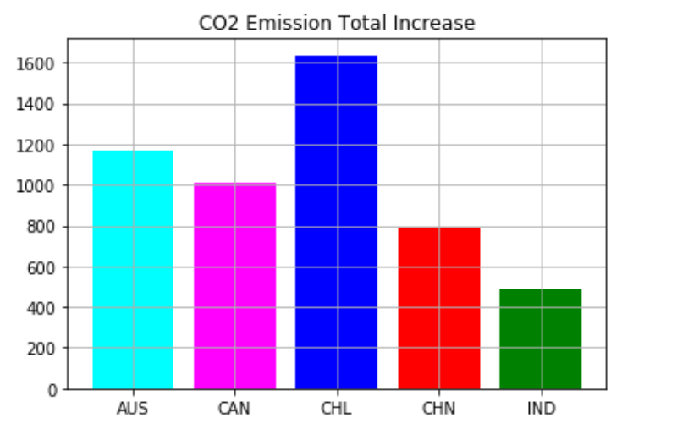
Question Answered!
Did CO2 emission increase as population increase?
CO2 emission does not increase as population increases. As India has the biggest population growth (~120 billion people),but their CO2 emission is not highest. CO2 emission increase is highest in Chile, which is over 1600 KtCO2.

Slide 21
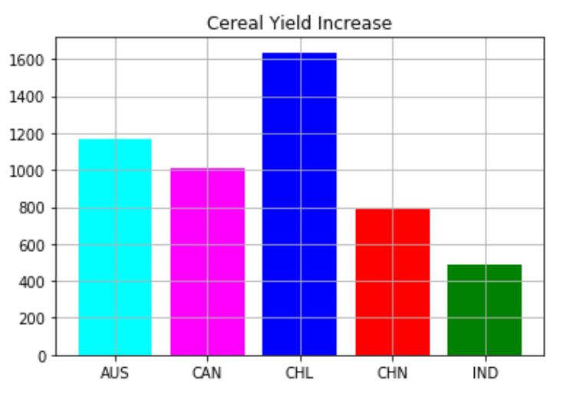
Question Answered!
Did population increase affect cereal yield(%)?
Cereal yield is not affected by population. The country that has biggest increase is Chile(production increase is over 1600(kg per hectare)), but their population growth is very small.

Slide 22
Temperature Changes Analysis

Slide 23
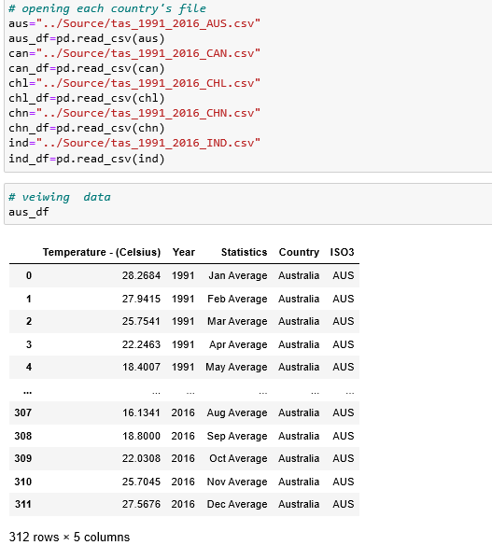
Cleaning Data – 1st Step

Slide 24
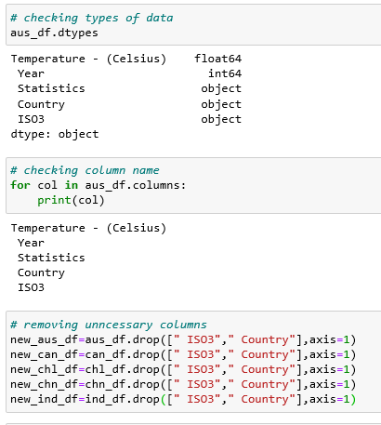
Cleaning Data -2nd Step

Slide 25
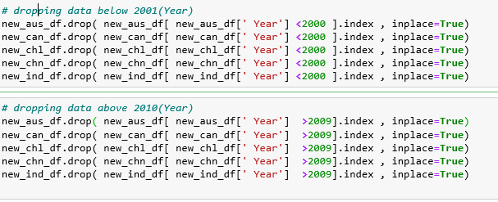
Cleaning Data – 3rd Step

Slide 26
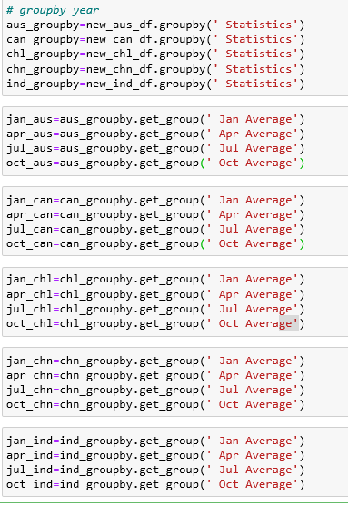
Analyzing Data – 1st Step

Slide 27
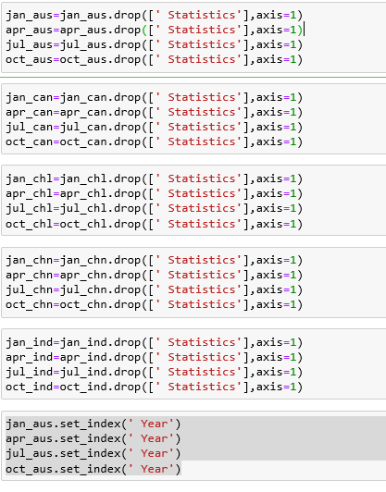
Analyzing Data – 2nd Step

Slide 28
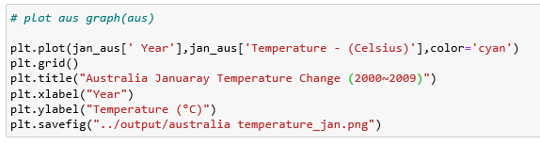
Analyzing Data – 3rd Step

Slide 29
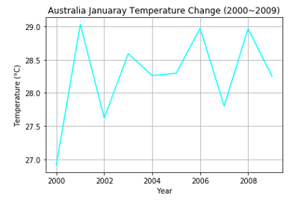
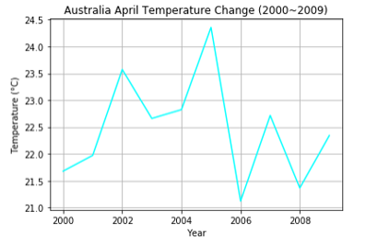
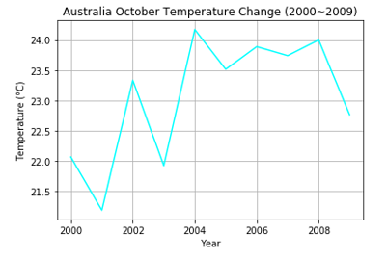
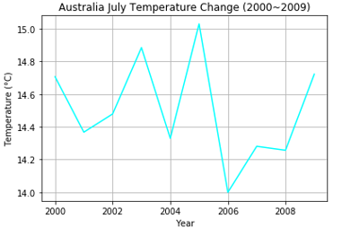
Australia Temperature Change (Jan, Apr, Jul, Oct)

Slide 30
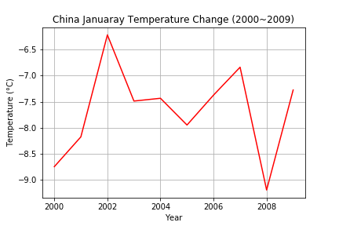
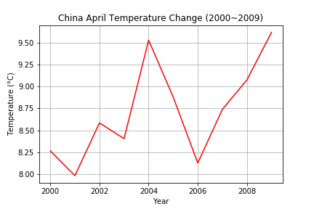
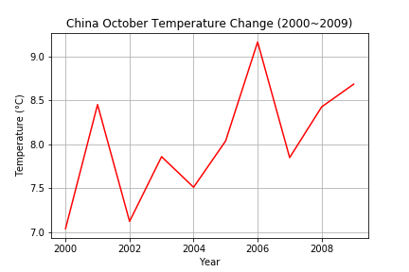
China Temperature Change (Jan, Apr, Jul, Oct)

Slide 31
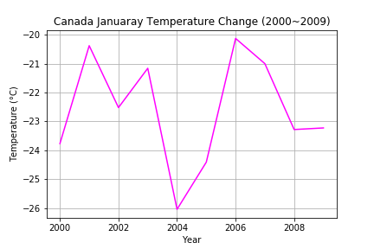
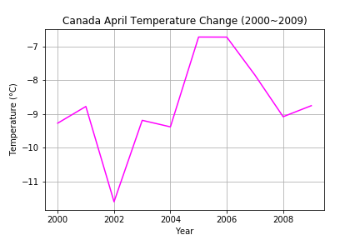
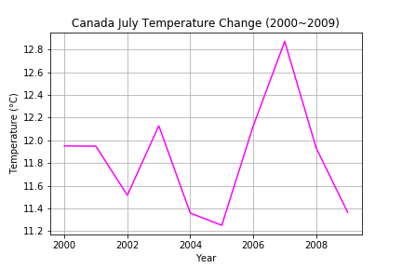
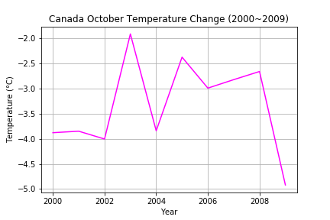
Canada Temperature Change (Jan, Apr, Jul, Oct)

Slide 32
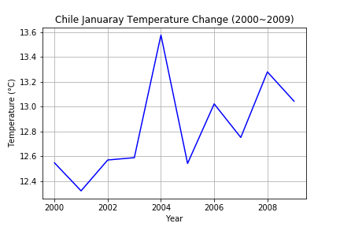
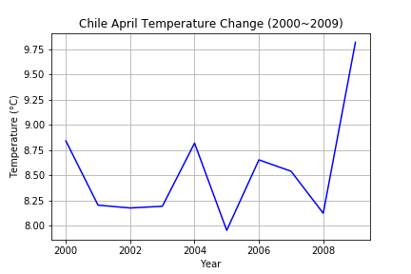
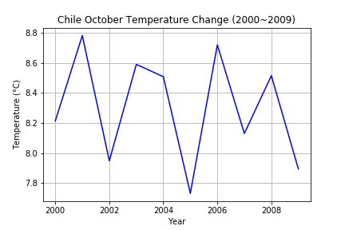
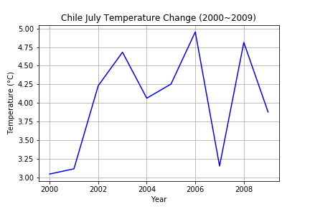
Chile Temperature Change (Jan, Apr, Jul, Oct)

Slide 33
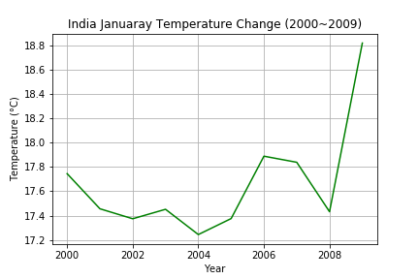
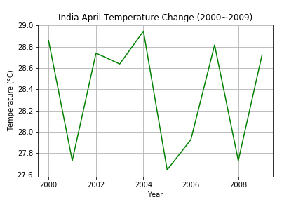
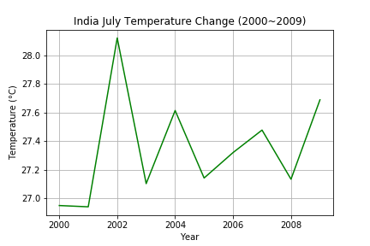
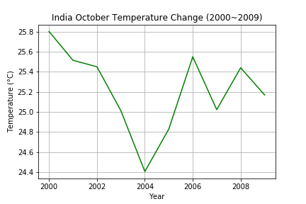
India Temperature Change (Jan, Apr, Jul, Oct)

Slide 34
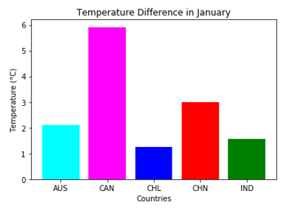
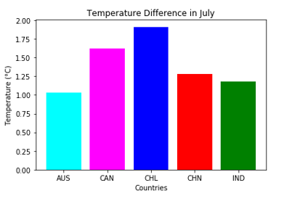
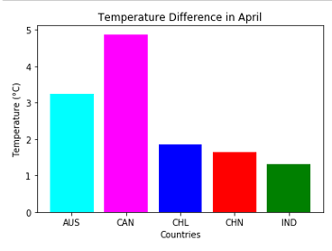

Question Answered!
Is temperature change occurring on all countries?
Yes, there is temperature change occurring on all countries. All 5 countries have noticeable change on all the months that are analyzed.
The country with biggest difference is Canada, which has 5.9 Celsius change in January.

Slide 35
Conclusion
There is definitely climate change happening in the world as temperature change is present.
The causes of climate changes that are analyzed did not show the relationship as expected. Further investigation is needed to find some causes of climate change in the future project.

